Slide 1


HORIZON GAME STORE
Konstantinos Nikopoulos
George Anthony Carlosviza-Morales
Saqib Ahmad Syed

Slide 2

How did you divide the work among your team ?
It was a team effort we all shared ideas and helped each other when one member got stuck.

Slide 3
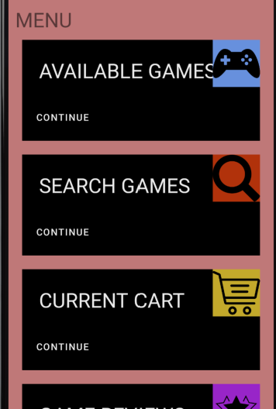
WHO WORKED ON WHAT ?
Responsible for most of the designs
Adding, creating, and deleting the users from the database
Making sure the music kept on playing
Creation and Implementation of User and Admin Login
Implementation of Available Games
Implementation of Search

Slide 4
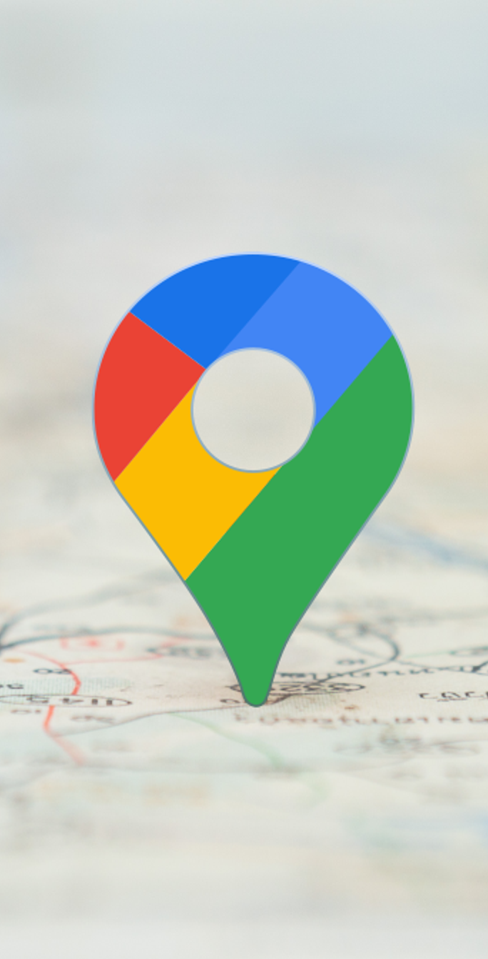
WHO WORKED ON WHAT ?
Creation and Implementation of User and Admin Login
Google Maps implementation
Modifying the database
Implementation of Add to cart and cart
Implementation of Search game
Implementation of Available Games
Implementation of Profile

Slide 5

WHO WORKED ON WHAT ?
General Testing
Creation and Implementation of User and Admin Login
Google Maps implementation
Implementation of Find Stores
Implementation of Available Games
Implementation of Game News

Slide 6
How did you determine which features to include in your app?
Music ON/OFF
Display video game stores
Create, add, delete User

Slide 7
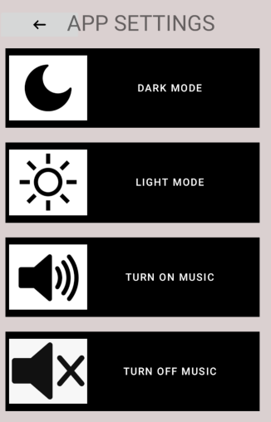
Excluded features?
DARK MODE
LIGHT MODE

Slide 8
How did you choose which technologies to use?
SQLite
GitHub
Discord
Android studio

Slide 9
What were some major difficulties that you have overcome?
GOOGLE MAPS
Retrieving game title data
SQLite connectivity

Slide 10
What went easier than expected?
MUSIC
MAP
Displaying all the user’s options
Recyclerview on the home page
Recyclerview displaying the users in admin page

Slide 11
How can you improve your app in the future?
Design it more to todays standards
Increase security
Different music options

Slide 12
How did you deal with git conflicts?
Uses another program to send files between team members, manually fixing mistakes

